Slide 1
Introduction To Programming
Chapter 10

Slide 2
Introduction To Programming
A Program is also called a software.
Is a set of instructions.
Ada Lovelace developed first program.
FORTRAN was the first high level language.
Initial programs written in machine language.
Assembly language used words like ADD, SUB and so on.
High level language used human readable text.
LISP is used for scientific calculations.

Slide 3
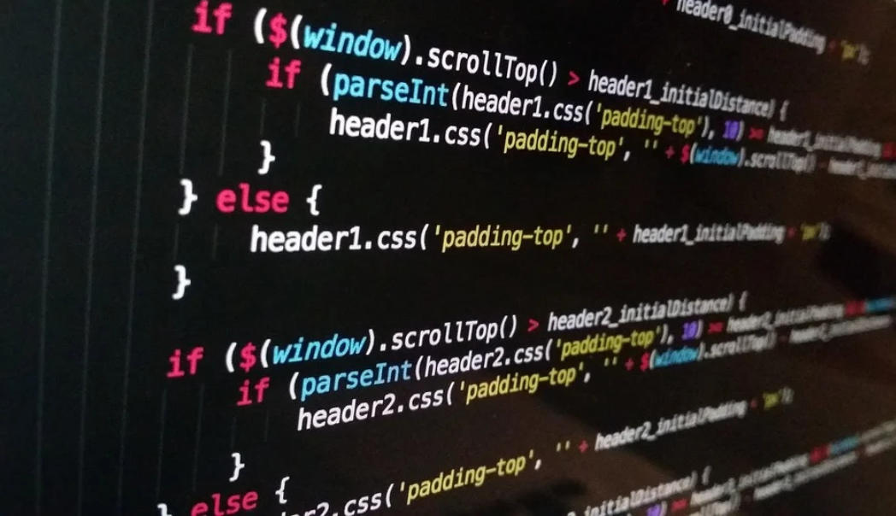
A Program
A Program has:
Variables & Constants
Statements
Conditional Constructs
Branching
Loops
Input & Output
Image Source: https://pixabay.com/photos/technology-computer-black-code-1283624/

Slide 4
Characteristics Of Programming Languages
Usability: Provides relevant functionalities.
Efficiency: Use minimum resources in least time.
Robustness: Good at error handling.
Maintainability: Work with new features.
Portability: Works across different platforms.

Slide 5
Tools To Convert To Low Level Language
Interpreter: Step by step translation of source code to machine code.
Compiler: Complete translation of source code.
Assemblers: Convert assembly language into binary.

Slide 6
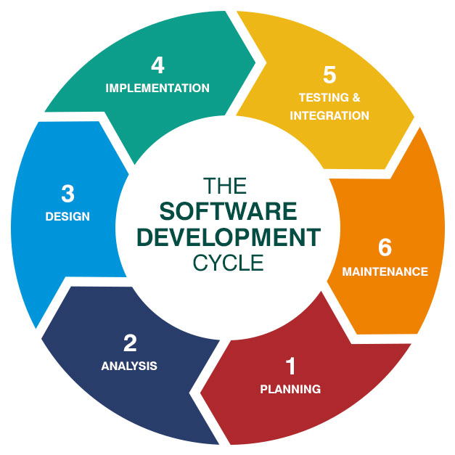
Programming Development Cycle

Slide 7
Programming Development Cycle
Planning: Information gathering and cost-benefit analysis done.
Analysis: Problem-solution step, define project goals.
Design: Defines the architectural model.
Implementation: Execution phase of project.
Testing and Integration: Tested for errors and loopholes.
Maintenance: Regular maintenance for working.

Slide 8
Input, Processing, Output
Input Processing Output or IPO model.
A storage memory for storing intermediate result.
Feedback in some systems available.
Program passes through three phases.
  Input
  Processing
  Output

Slide 9
Input, Processing, Output In Programming
Input is raw data given by users.
Input is human readable text.
Input can be one or more than one.
Input converted to machine code.
Processing for calculations.
Processing done in binary numbers.
Processing takes place in CPU.

Slide 10
Input, Processing, Output in Programming
CPU has CU, ALU and memory for processing.
Processing makes data meaningful.
Output converts data into human readable form.
Output may be one or more.

Slide 11
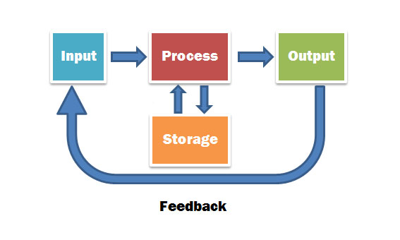
Input Processing Output Model With Feedback

Slide 12
Converting Flowcharts To Program
Flowcharting converts algorithms to flowcharts.
Coding transforms flowcharts into programs.
Three main step in conversion are:
  Determining the input and output.
  Develop the logic.
  Writing the code.

Slide 13
Food For Thought
Brain, first computer virus invented for MS-DOS in 1986.
Made by two brothers in Pakistan.
To defend illegal software distribution.
Infected FAT system.
After attack, system displayed details and phone number for contact.

Slide 14
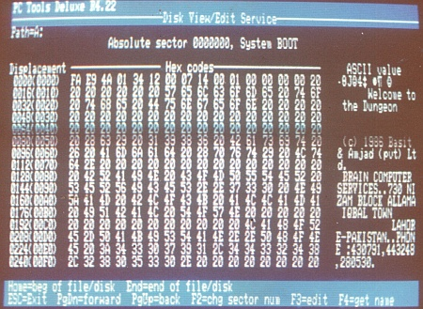
The Brain Virus Hex Code

Slide 15
Final Words
Programs are the core of computers.
Hardware is useless without instructions.
Newer programming languages are always emerging for various purposes.
Developers have a huge role.
Languages are becoming lesser and lesser complex now.

